Slide 1
Dessert Stream
CS6650 Fall 2018
Group members:
Prakriti Dave & Survi Satpathy

Slide 2
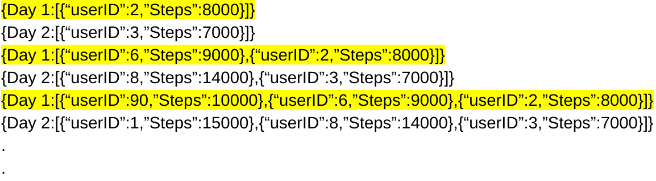
Use Case - Find the top K users with maximum step counts per day
Intended output :

Slide 3
Hypothesis - Finding top K users with max step count per day is faster when using Apache Kafka and KStream
than traditional relational database because
Calculating top K users would require sorting all the users by their step count
Aggregation in database: Group by user ID, day ->Sum(Steps). This operation can be slower in a big SQL database
To get the result from a relational database the sum of steps for each user has to be calculated periodically time and again or cached

Slide 4


Architecture Design
Steps:
Create Kafka Producer for JSON data of each user: {"userID":1,"day":1,"hour":2,"steps":30}
Create a Spout & Bolt to aggregate user data based on key: {userID, day}
Send the Storm Topology data to Kafka Broker topic - “UserStepsPerDay”
Use KStream Builder to create KStream from the Kafka Topic

Slide 5
Architecture Design
Steps:
5. Set key as ‘day’ and value as {userID,totalSteps}
6. Aggregate by key and update top K users by step counts
7. Produce running top Kusers to Kafka topic
8. Print top K to console/store in data source

Slide 6
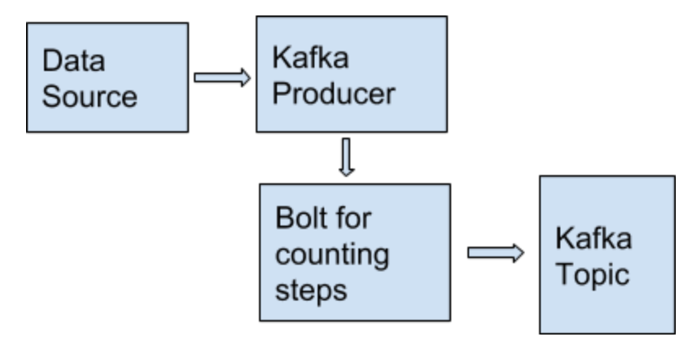
Architecture Design
Steps 1 through 3:
The Spout & Bolt config aggregates by User ID and Day and forwards it to a TopologyBuilder.
The output from the storm topology should be forwarded to a new Kafka topic

Slide 7
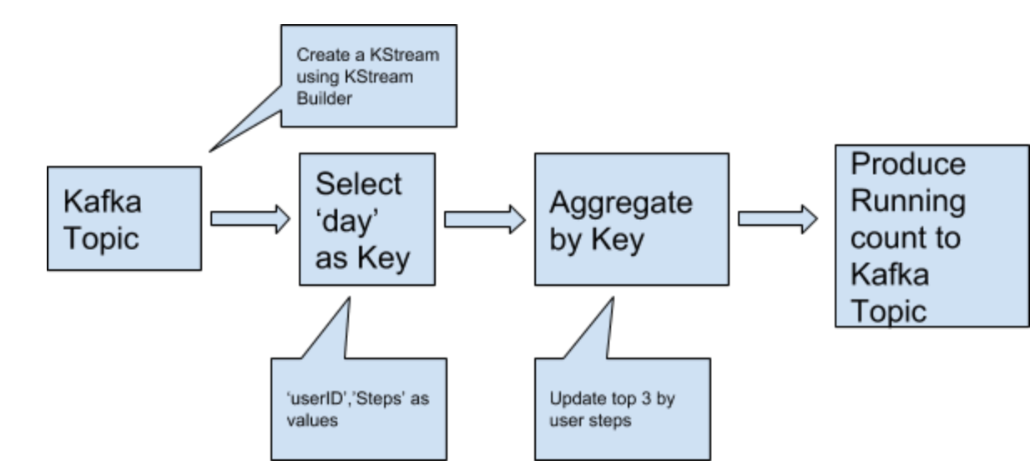
Architecture Design
Steps 4 through 8:

Slide 8
Architecture Design
For report generation -
Consumer application that periodically fetches the current Top K user IDs aggregated so far by listening from the output Kafka Topic of KStream
For persistence -
Consumer application which loads the Top K User Ids per day to a MongoDB.
For scaling of Kafka Cluster -
Amazon Managed Streaming of Kafka(MSK)

Slide 9
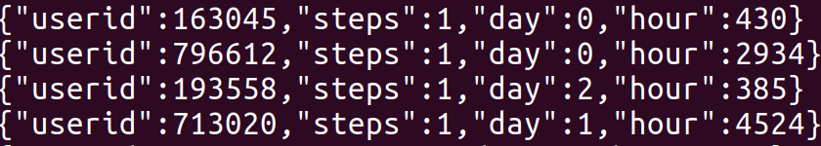
Story so far…
Kafka producer sends user data in JSON format for the topic-”UserSteps”.
Topology builder converts it to a stream
Links :
https://technology.amis.nl/2017/02/12/apache-kafka-streams-running-top-n-grouped-by-dimension-from-and-to-kafka-topic/#prettyPhoto
https://www.tutorialspoint.com/apache_kafka/apache_kafka_integration_storm.htm

Slide 10
Any Questions?

